Slide 1
Twitter
Escondido Indivisible (@EscInd50)

Slide 2
Note: presentation will be made available for download.
Audience
For those unfamiliar with Twitter
For those familiar with Twitter, but hesitant about learning new technology
Assumption about Technology Knowledge
From those who don’t know how to use the phone text message function to those who understand intuitively how software works
Goals
Go over the basics of Twitter
Keep presentation short & simple to not overwhelm

Slide 3
What is Twitter?
Twitter is like a text message or telegram posted publicly to a group of followers.
You are allowed only 140 characters per message.

Slide 4
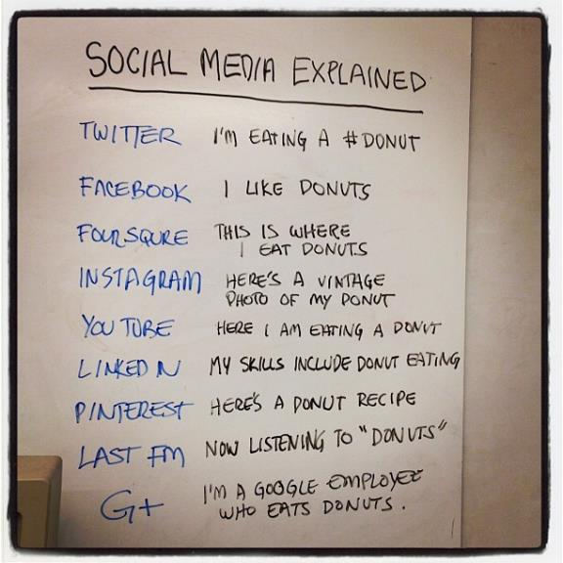
Social Media Explained
TWITTER I’m eating a #donut
FACEBOOK I like donuts
FOURSQUARE This is where I eat donuts
INSTAGRAM Here’s a vintage photo of my donut
YOUTUBE Here I am eating a donut
LINKEDIN My skills include donut eating
PINTEREST Here’s a donut recipe
LASTFM Now listening to “donuts”
GOOGLE PLUS I’m a Google employee who eats donuts
Social Media Explained with Donuts by Doug Ray

Slide 5
Glossary
FOLLOWER A Twitter account that you follows by clicking on the Follow button on Twitter.
HASHTAG A hashtag is like a slogan or a search term. It allows other users to easily find your message based on a certain theme, e.g. #ResistTrump, #StandIndivisible, #ICEOutofCA.
LIKE A message that you “like” by clicking the heart (❤) button on Twitter.
REPLY A reply to the Tweet. It’s different from a Retweet in that only your comments will be posted on your Twitter.
RETWEET A repost of a Tweet in which you can add your own comments or simply repost the Tweet without comments.
TIMELINE A timeline shows messages that you posted and messages from Twitter accounts that you have followed (if any).
TWEET A message posted on Twitter.
TWITTER A social media service that allows you to post a message publicly to a group of followers. It works like a text message or a telegram, and allows you to post a message of only 140 characters. A Twitter account is often simply referred as Twitter.

Slide 6
How to Sign Up for a Twitter Account
You’ll need a Twitter account to:
Post a message
Reply, retweet or like a message
Follow another user
You don’t need a Twitter account to:
Look at a public message
Browse a public Twitter account
Browse Twitter in general
Go to twitter.com
Click on Sign up button to sign up and follow the instructions. You’ll need:
An email address or a phone number
An username for your Twitter account
A password for your Twitter account
After you’ve created a Twitter account, click on the Log in button to log in to your account
Recommendation
Use your organization email if you’re creating a Twitter account for your organization

Slide 7
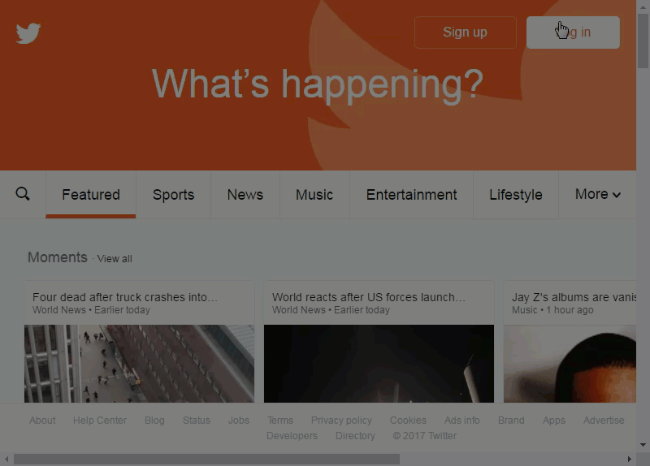
Demo: How to Sign Up for a Twitter Account

Slide 8
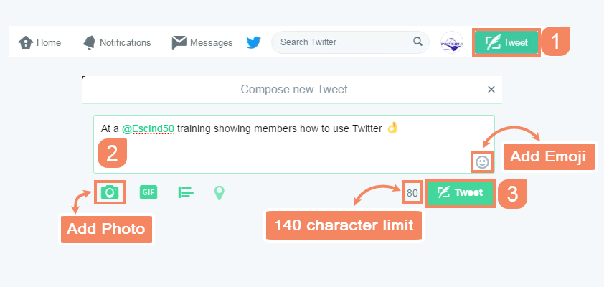
How to Tweet (Post a Message)
Click on the Tweet button to create a new message.
Type a message. Similar to a telegram, there is a 140 character limit.
Click on the Tweet button to post the message.
Click on the camera button to add a photo.
Click on the smiley face to add emoji

Slide 9
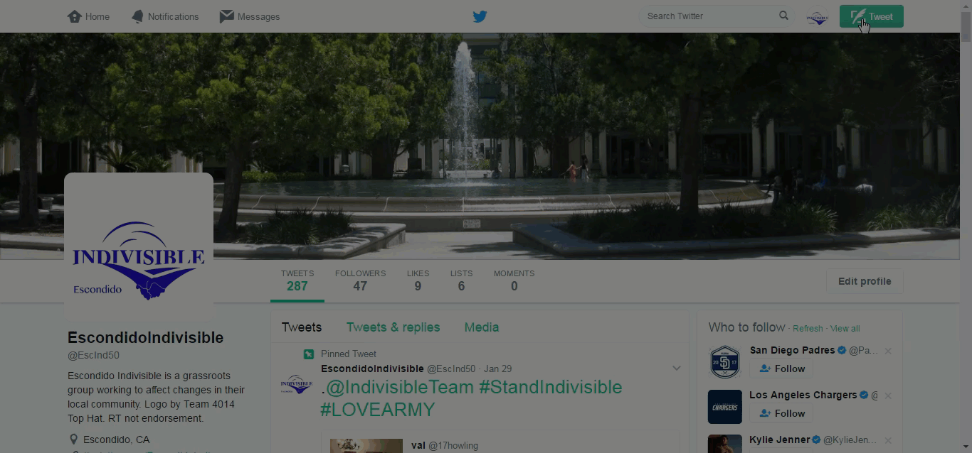
Demo: How to Tweet (Post a Message)

Slide 10
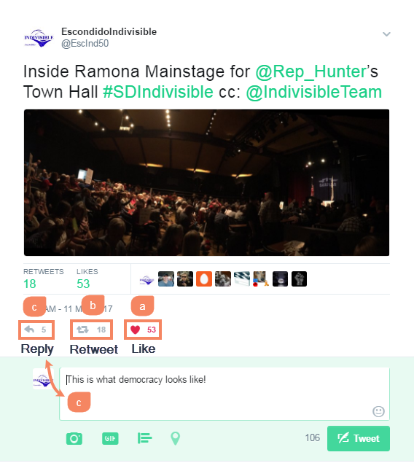
How to Like, Retweet & Reply to a Tweet
Click on the heart button to like a Tweet.
Click on the double arrows button to retweet or repost a Tweet.
Click on the curve arrow to reply to a Tweet. Then:
Type a message.
Click on the Tweet button to post the message.

Slide 11
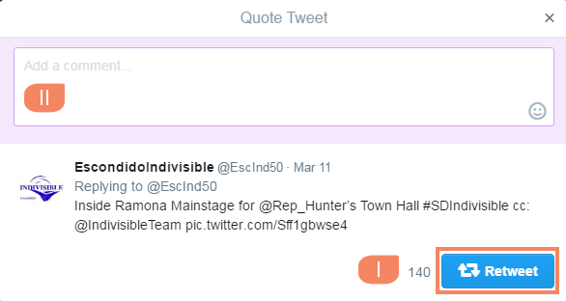
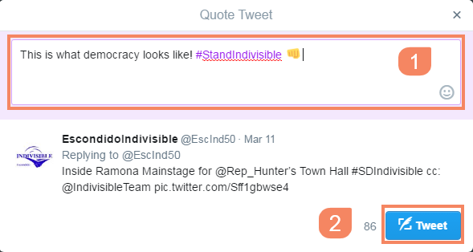
How to Add a Comment to a Retweet
To simply retweet without comments, click on the double arrows Retweet button.
To add a comment, go to the “Add a comment…” window. Then:
Type a message.
Click on the Tweet button to post the message.

Slide 12
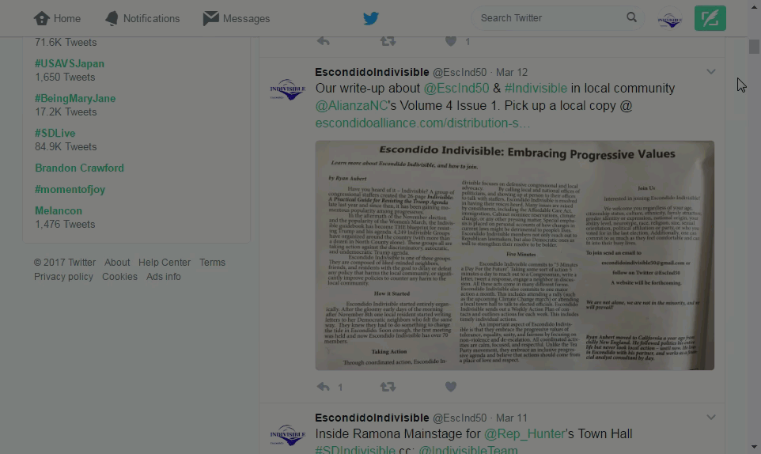
How to Like & Retweet a Tweet (Repost a Message)

Slide 13
How to Reply to a Tweet

Slide 14
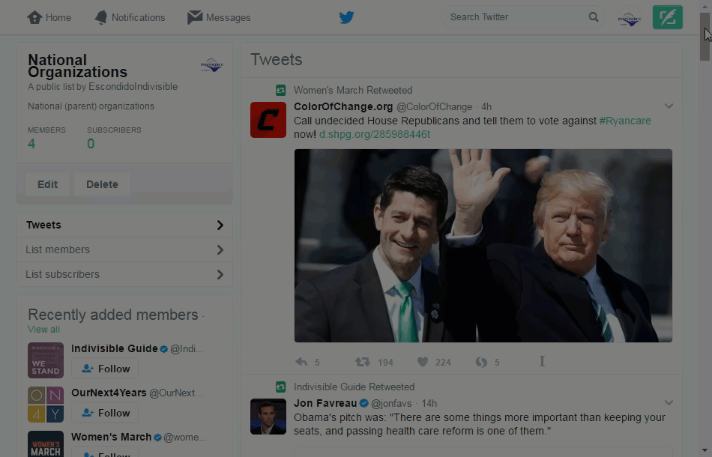
Demo: How to Follow Another Twitter
To follow another Twitter account:
Go to the account profile, e.g. twitter.com/EscInd50
Click on the Follow button
To unfollow another Twitter account:
Go to the account profile, e.g. twitter.com/EscInd50
Click on the Following then Unfollow button

Slide 15
Questions?

